Slide 1

HarvestHub
TEAM NAME :
SRI VENKATESHWARA COLLEGE OF ENGINEERING
COLLEGE :
PROBLEM STATEMENT :
Direct Farmer-to-Buyer Marketplace to avoid intermediate,artificial demands and tracking the products(LOGISTICS)

Slide 2

Direct Farmer-to-Buyer Marketplace to avoid intermediate and artificial demands:
Create a digital platform that connects farmers directly with buyers, allowing them to transact without the need for intermediaries. This platform can facilitate the buying and selling of agricultural products, ensuring fair prices for farmers and transparent sourcing for buyers. Avoiding artificially inflating demand and making sure the logistics works properly by tracking the products and supplying for the demand.

Slide 3

A DIGITAL PLATFORM, establishes direct connections between farmers and buyers, eliminating intermediaries. The platform ensures transparency and trust through detailed product listings, SECURE TRANSACTIONS, and a robust review system. Additionally,it addresses the ISSUES OF SURPLUS PRODUCTS by facilitating sales in demanded locations. It combats problems associated with intermediaries STORING PRODUCTS, ARTIFICIALLY INFLATING DEMAND, and subsequently selling them at higher prices. With features like SUPPLYCHAIN TRACKING,DIGITAL CONTRACTS and MAP INTEGRATIONS.Revolutionizes agricultural trade, empowering farmers and providing buyers access to quality products in a fair and efficient marketplace.

Slide 4
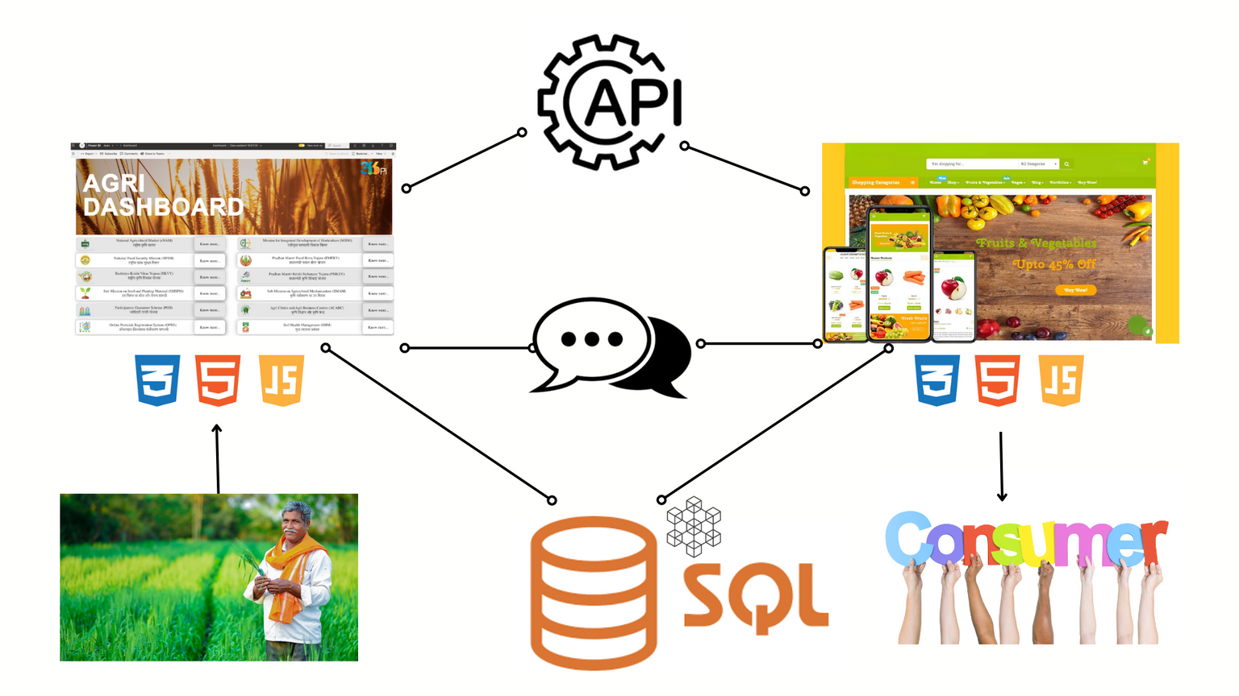

Slide 5

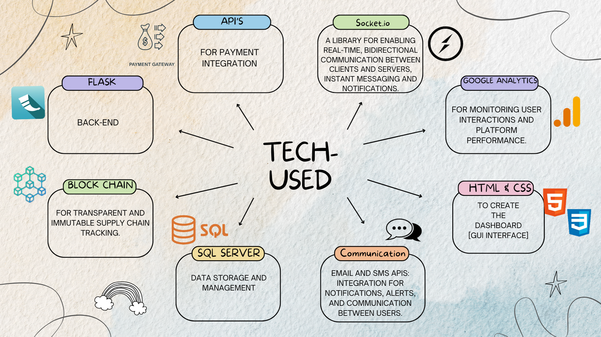

Slide 6

The target market for the digital platform connecting farmers directly with buyers includes
1. Farmers: Wanting to sell their produce directly to buyers without intermediaries.
2. Individual Consumers: Looking for convenient access to farm-fresh products for their households.
3. Grocery Stores: Interested in offering a wider variety of fresh produce to their customers.
4. Restaurants and Cafés: Seeking fresh and locally sourced produce for their menus.
5. Food and Beverage Manufacturers: Requiring bulk supplies of specific agricultural products for production.
This order starts with the primary target market of farmers and then progresses to individual consumers and various types of businesses, ending with food and beverage manufacturers.

Slide 7

1. Subscription Model for Buyers: Offer tiered subscription packages for buyers to access the platform and purchase directly from farmers.
2. Transaction Fees: Charge a small fee for each transaction processed through the platform.
3. Premium Listings for Farmers: Allow farmers to pay for premium listings to increase product visibility and attract more buyers.
4. Advertising Revenue: Generate income through targeted advertising on the platform from relevant agribusinesses.
5. Value-Added Services: Provide additional services like logistics support or market insights for an extra fee.
6. Partnerships and Sponsorships: Collaborate with agricultural organizations or corporate sponsors for funding or promotional opportunities.
7. Data Monetization: Analyze transaction data to offer insights to stakeholders or sell aggregated data to researchers.
8. Commission from Ancillary Services: Earn a commission by facilitating ancillary services like financial products or advisory services through the platform.

Slide 8

Role | Name | Stream/Dept | Year | College
LEADER | LEENA | ECE | II | SVCE
FRONT-END | RENUKA DEVI | ECE | II | SVCE
BACK-END | LAVANYA V | ECE | II | SVCE
INTEGRATIONS & DATABASE | M RAMANATHAN | ECE | II | SVCE

